Slide 1



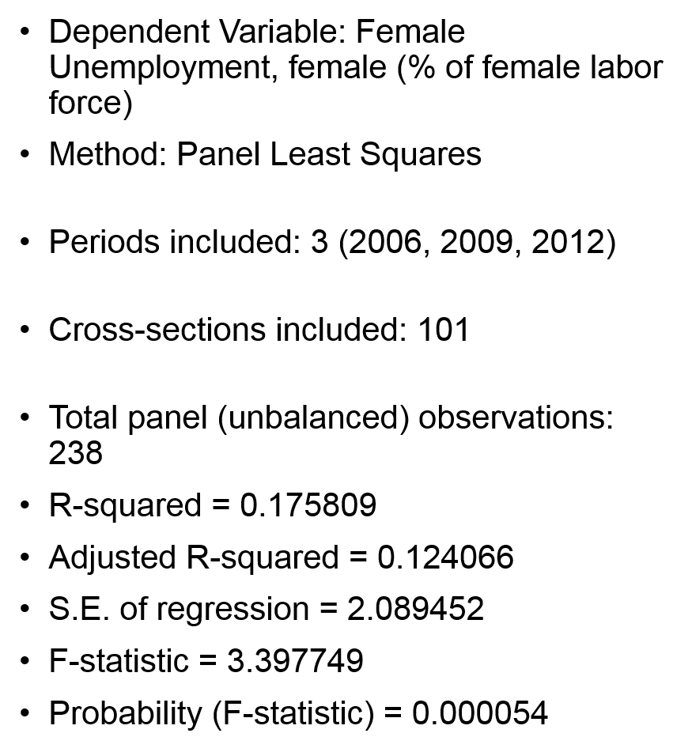
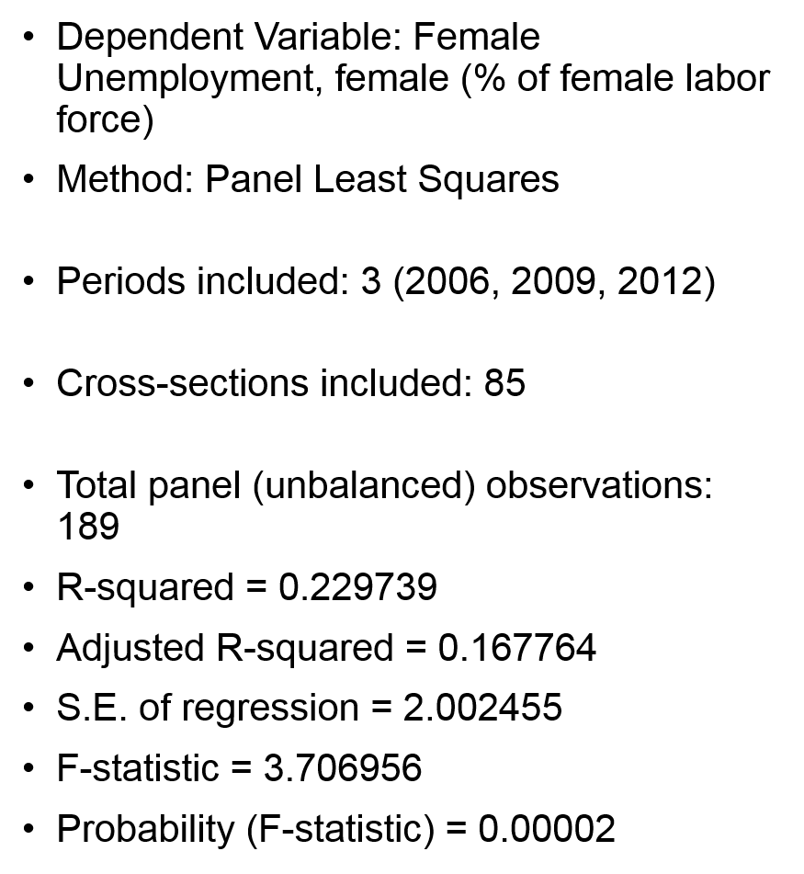
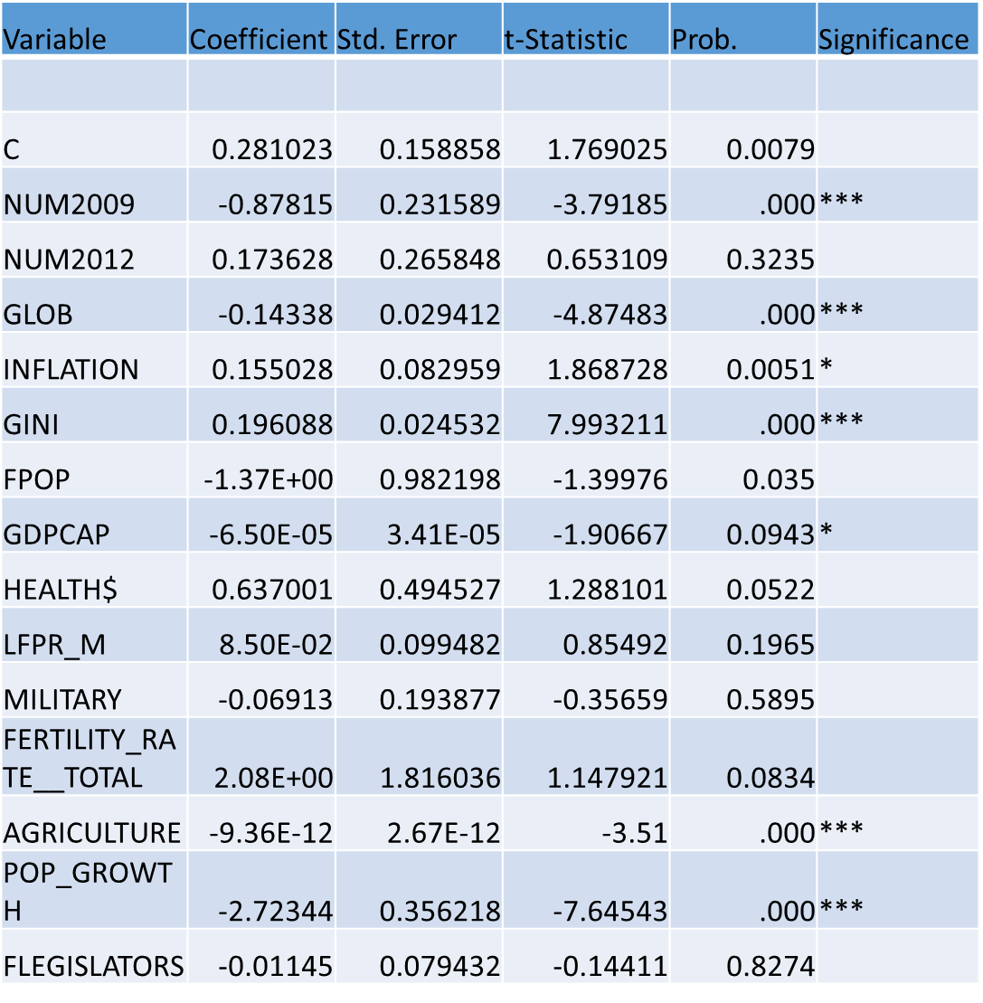
Importing Gender Equality: Globalization, Female Employment and the Female Labor Participation Rate
Rachel Antoinette Lewis, Economics
Mentor: Yassaman Saadatmund
Abstract
Methods
Results
This study investigates the impact of globalization on the employment of women and female labor force participation rate of a sample of 101 developed and developing countries during 2003-2012. To identify the combined effect of the economic, political and social globalization, I conducted an econometric regression with female unemployment being the dependent variable. T account for two correlated control variables, fertility rate and average years of schooling for females, I have applied two models. My main finding show that globalization has a small and negative impact on unemployment. This suggests that globalization improved the hiring of women. The results support the implications of Becker’s theory and many of the academic papers written about female employment and the female labor participation rate . Also, the evidence shows that the higher the country’s population growth rate, the more likely women are to enter the workforce.
Raw data was collected from the World Bank databases and the KOF Index of Globalization. To account for multicollinearity between fertility rate and expected years of schooling for females, each variable is used in a separate model. Both of these models use manually demeaned data and period fixed effects to account for unobservable fixed effects, and to partially address endogeneity that is associated with omitted variable bias. In addition, to account for serial correlation, [{n*t-k}/{n*(t-1)-k}] is used to create a correction factor which is multiplied with the initially underestimated standard errors to recalculate accurate t-statistics (Wooldridge, 2002). Finally, heteroskedasticity was found in both of the models according to the test provided by Baum (2001). Hence, White's cross section correction was used to account for it (White, 1980).
Background
While there is a large amount of literature analyzing the impacts of trade liberalization on women employment and labor force participation across skill and income, there is very little is known about the gender effects of trade reforms and social globalization . However, the lack of female employment and the female labor participation affect most countries around the world because of traditional gender roles, religion preference, civil freedom and absence of integration. Recent literature on gender and globalization is largely centralized around Gary Becker’s Economics of Discrimination Theory (1957) that states competition decreases discrimination. Based on Becker’s theory, the increase in foreign competition due to globalization will cause a reduction in discriminatory practices toward women because the employer prejudice is ‘driven out of the market’ in the long run.
Type additional information or methods here.
Future Research
References
Conclusions
The data presents only a small insight into how globalization affect the employment of women around the globe. According to World Bank, there are approx. 196 countries in the world and my regression used 101 of those countries. There are a number of reasons why data may not be available for some indicators for all countries and years. Some countries do not regularly report data due to conflict, lack of statistical capacity, or other reasons. Ideally, future studies will have more quality data observations for omitted countries. Also, there are other data issues that need to be addressed in future research. Theoretically, the countries’ primary religion, literacy rate, government regime along with other economic and social controls would have been included but they were obtainable.
Wooldridge, J. M. (2010). Econometric analysis of cross section and panel data. MIT press.
Baum, C. F. (2001). Residual diagnostics for cross-section time series regression models. The Stata Journal, 1(1), 101-104.
White, H. (1980). A heteroskedasticity-consistent covariance matrix estimator and a direct test for heteroskedasticity. Econometrica: Journal of the Econometric Society, 817-838.
Along with a host of academic research papers about globalization and female employment, gender wage inequality and female labor participation rate
I found that my variable of interest, globalization, does increase the employment of women. Thus, the highly statistically significant results support my branding theory: Globalization positively impacts the female employment in both developed and developing countries. Countries with higher inequality in the income distribution of its nation's residents, measured by the GINI index, are more likely to have less overall female employment. Macroeconomics factors such as GDP per capita and inflation are linked to female employment. GDP has a very large positive effect , while inflation has a fairly small negative effect. My research also indicates that countries with a larger female population percentage and higher population growth have more women working. Lastly, Agricultural value had the most prevalent positive effect on female employment.

